Slide 1

New features for GRNsight: a web application for visualizing models of small- to medium-scale gene regulatory networks
Kam D. Dahlquist, Ph.D.
Department of Biology
Loyola Marymount University
Bioinformatics Community Conference
Bioinformatics Open Source Conference
July 19-22, 2020

Slide 2
Open Science Ecosystem
Open Access
(creative commons)
Open
Source
Code
Open Pedagogy
Open Data
Open Science
(open process)
Reproducible
Research
Research
Integrity
Citizen
Science
With thanks to John Jungck

Slide 3
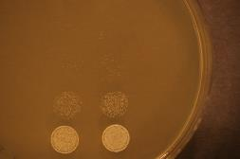
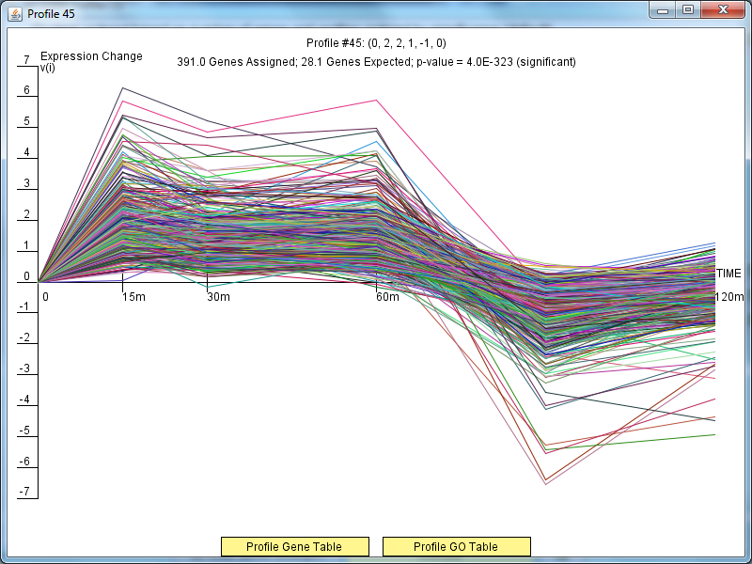
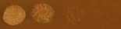
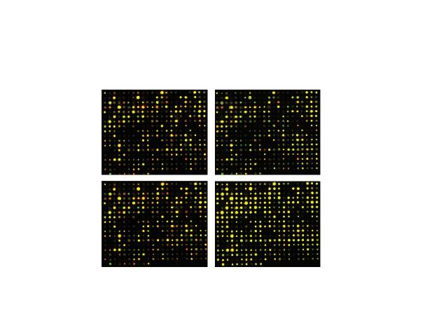
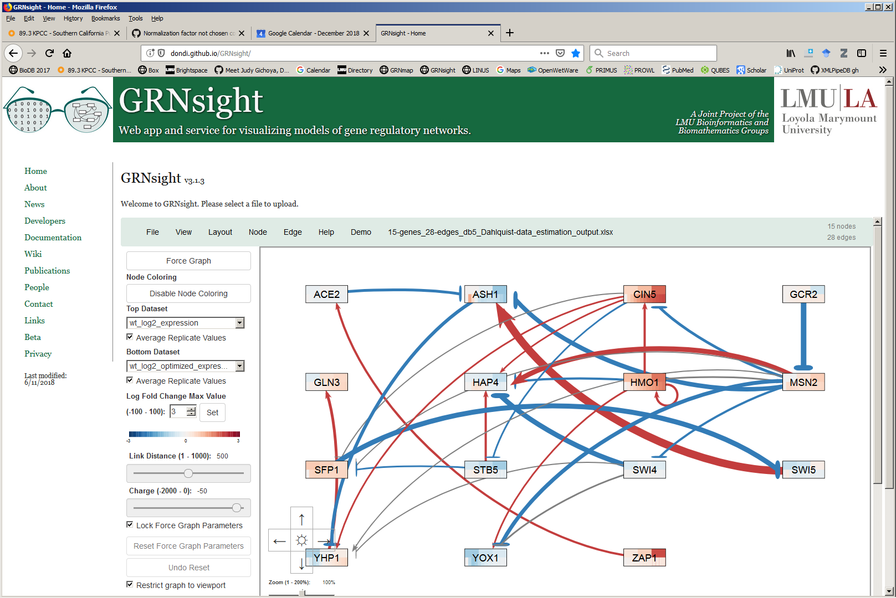
GRNsight Is Developed and Used by Undergraduates in Courses and an Interdisciplinary Research Team
wt
Cold shock microarray data from wt and TF deletion strains
15°C
Δash1
Interpretation,
new questions, new experiments
Normalization, statistical analysis, clustering
Visualization of modeling results using GRNsight
Derivation of gene regulatory networks from YEASTRACT
Dynamical systems modeling using GRNmap

Slide 4
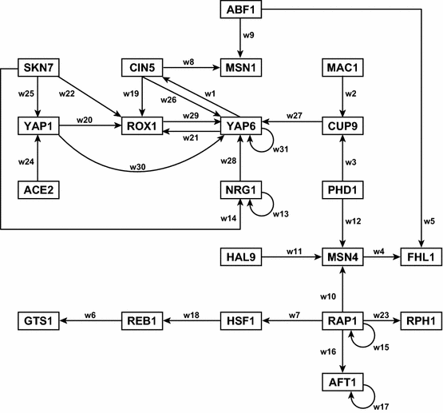
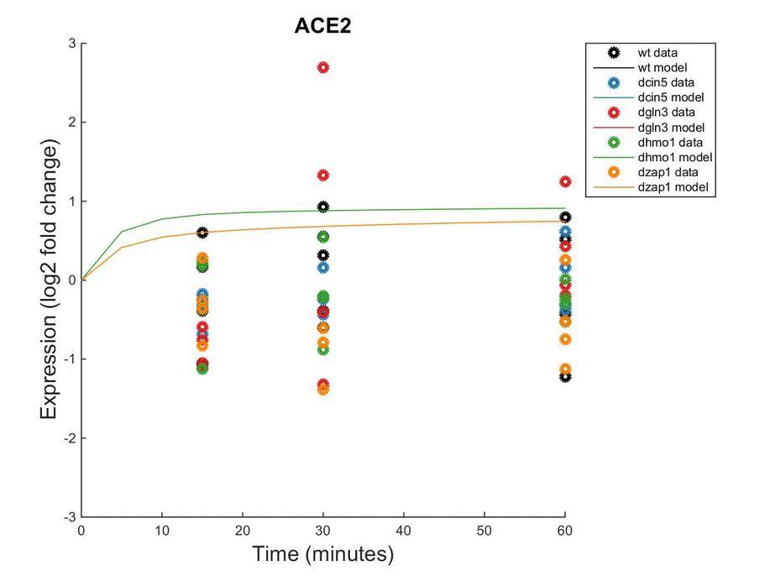
GRNmap: Gene Regulatory Network Modeling and Parameter Estimation
Weight parameter, w, gives the direction (activation or repression) and magnitude of regulatory relationship.
Dahlquist et al. (2015) Bulletin of Mathematical Biology 77: 1457.

Slide 5
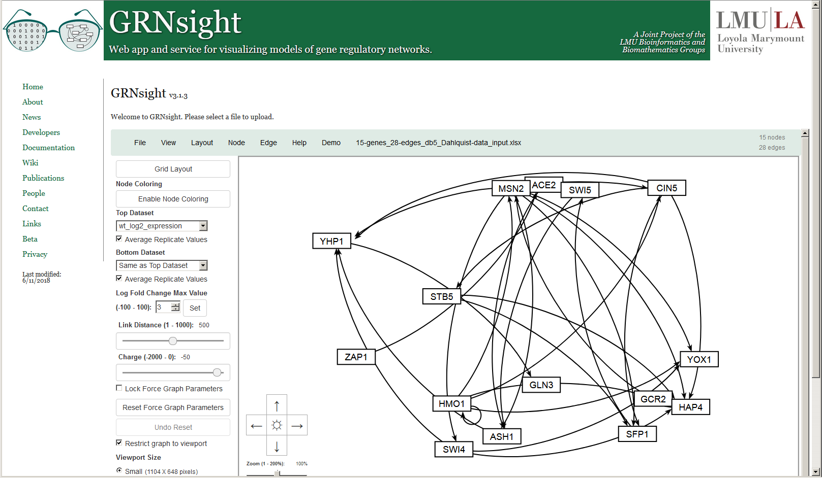
GRNsight Rapidly Generates GRN Graphs Using
Our Customizations to the Open Source D3 Library
Dahlquist et al. (2016) PeerJ Computer Science; Version 1 available March 2014

Slide 6
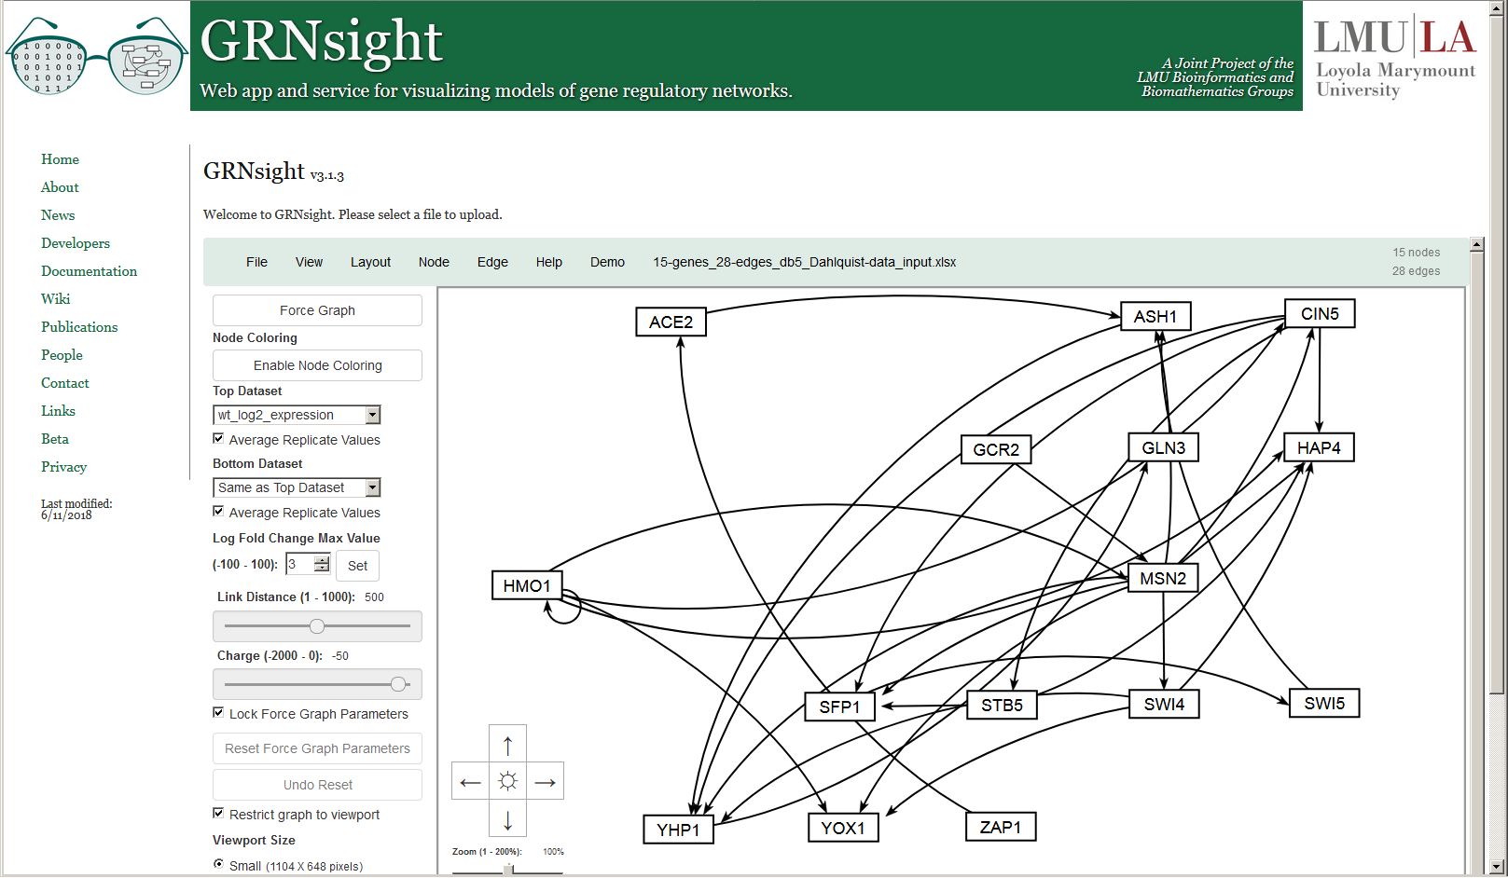
Besides the Force Graph Layout,
Users Can Rearrange the Nodes by Hand
Dahlquist et al. (2016) PeerJ Computer Science

Slide 7
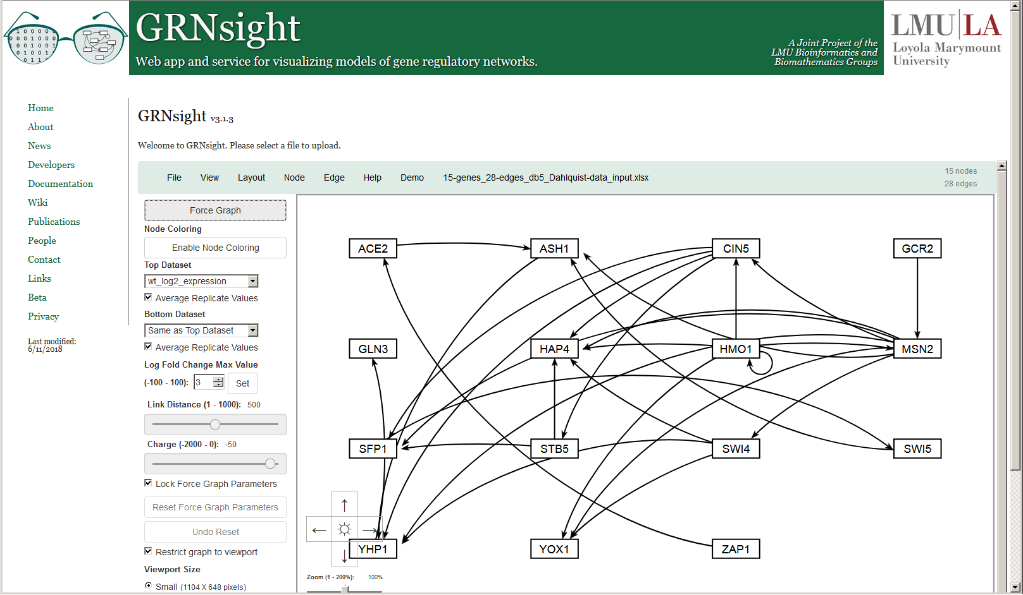
Or Choose the Convenient Block Layout Option
New in Version 3

Slide 8
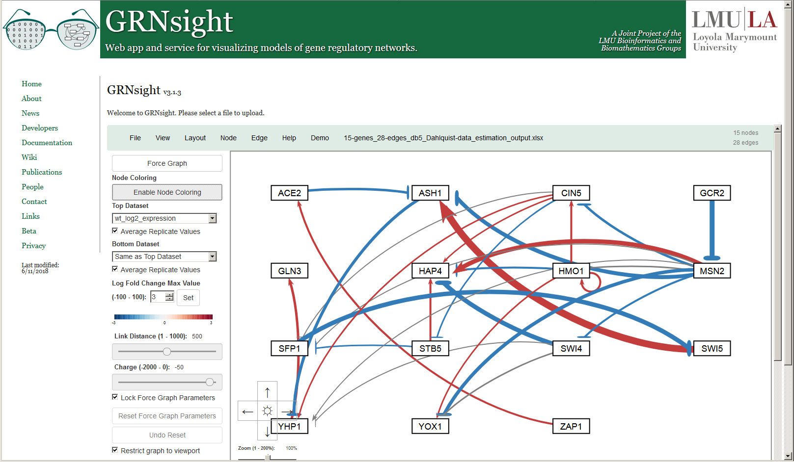
When Model Results are Loaded, Edge Weight Values
Are Indicated by Color, Thickness, and End Marker
New color scheme in Version 3

Slide 9
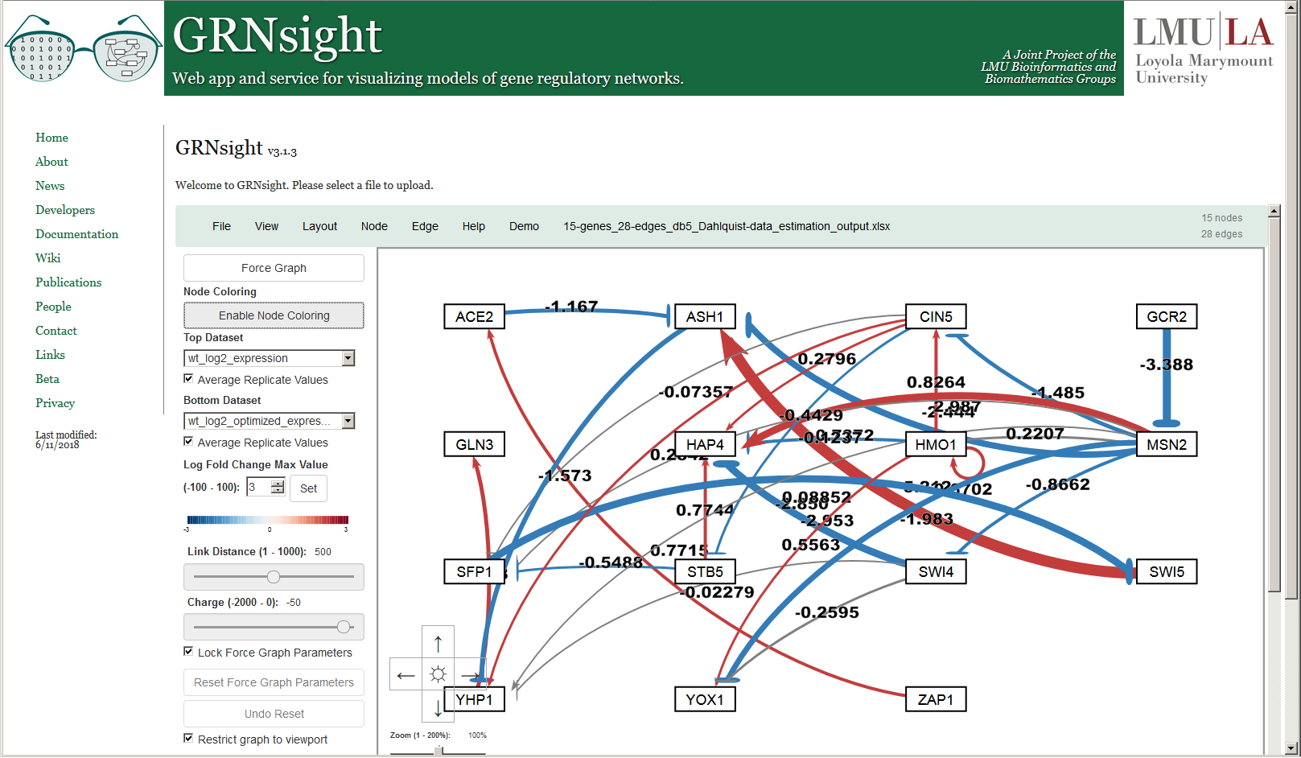
Numerical Weight Values Can Be Displayed on the Graph
New in Version 2

Slide 10
Edge Thicknesses are Normalized to the Largest Magnitude Weight Value
Normalization Factor = 5.21
Version 1

Slide 11
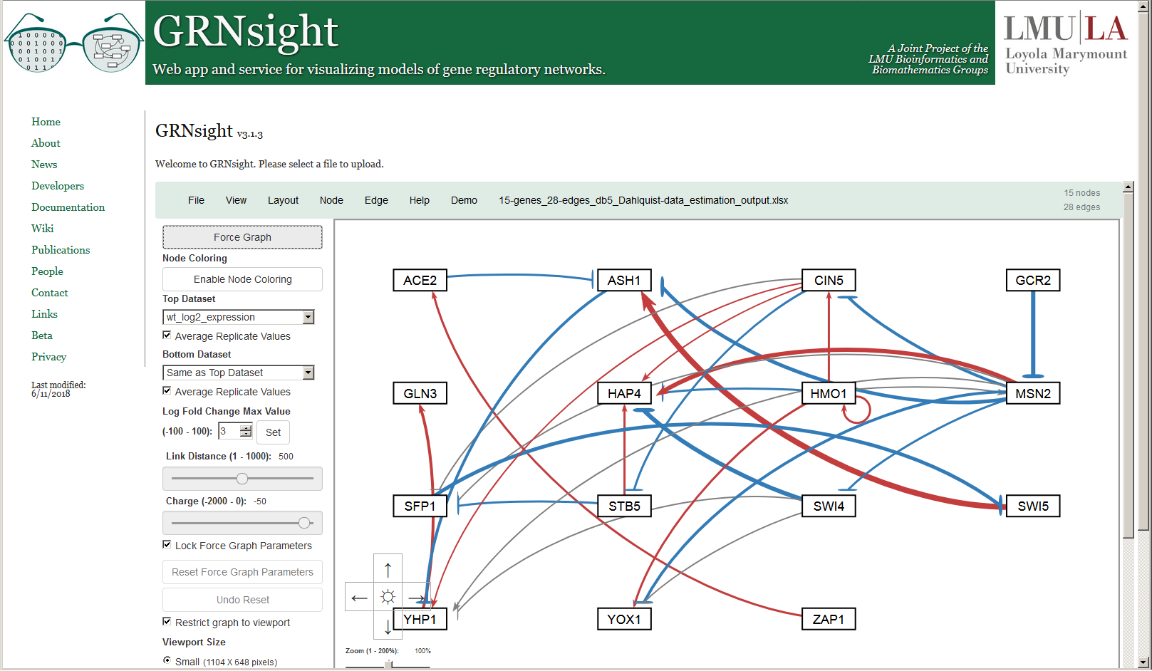
And Can Be Modified to Allow Fair Visual Comparison between Different Graphs
Normalization Factor = 10
New in Version 2

Slide 12
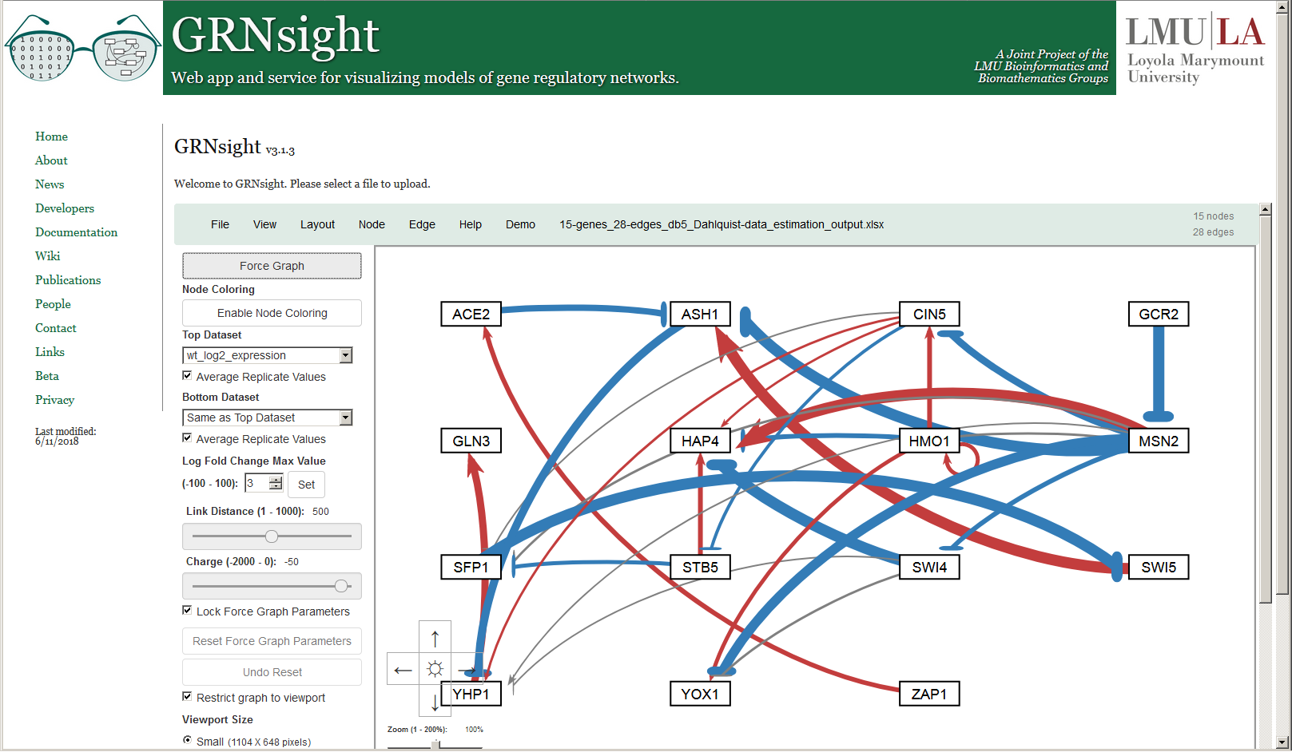
And Can Be Modified to Allow Fair Visual Comparison between Different Graphs
Normalization Factor = 2.5
New in Version 2

Slide 13
Edges with Normalized Weight Values within 5% of Zero
Are Displayed as Gray to Minimize Their Visual Strength
Normalization Factor = 5.21
Gray Threshold = 5%
Version 1

Slide 14
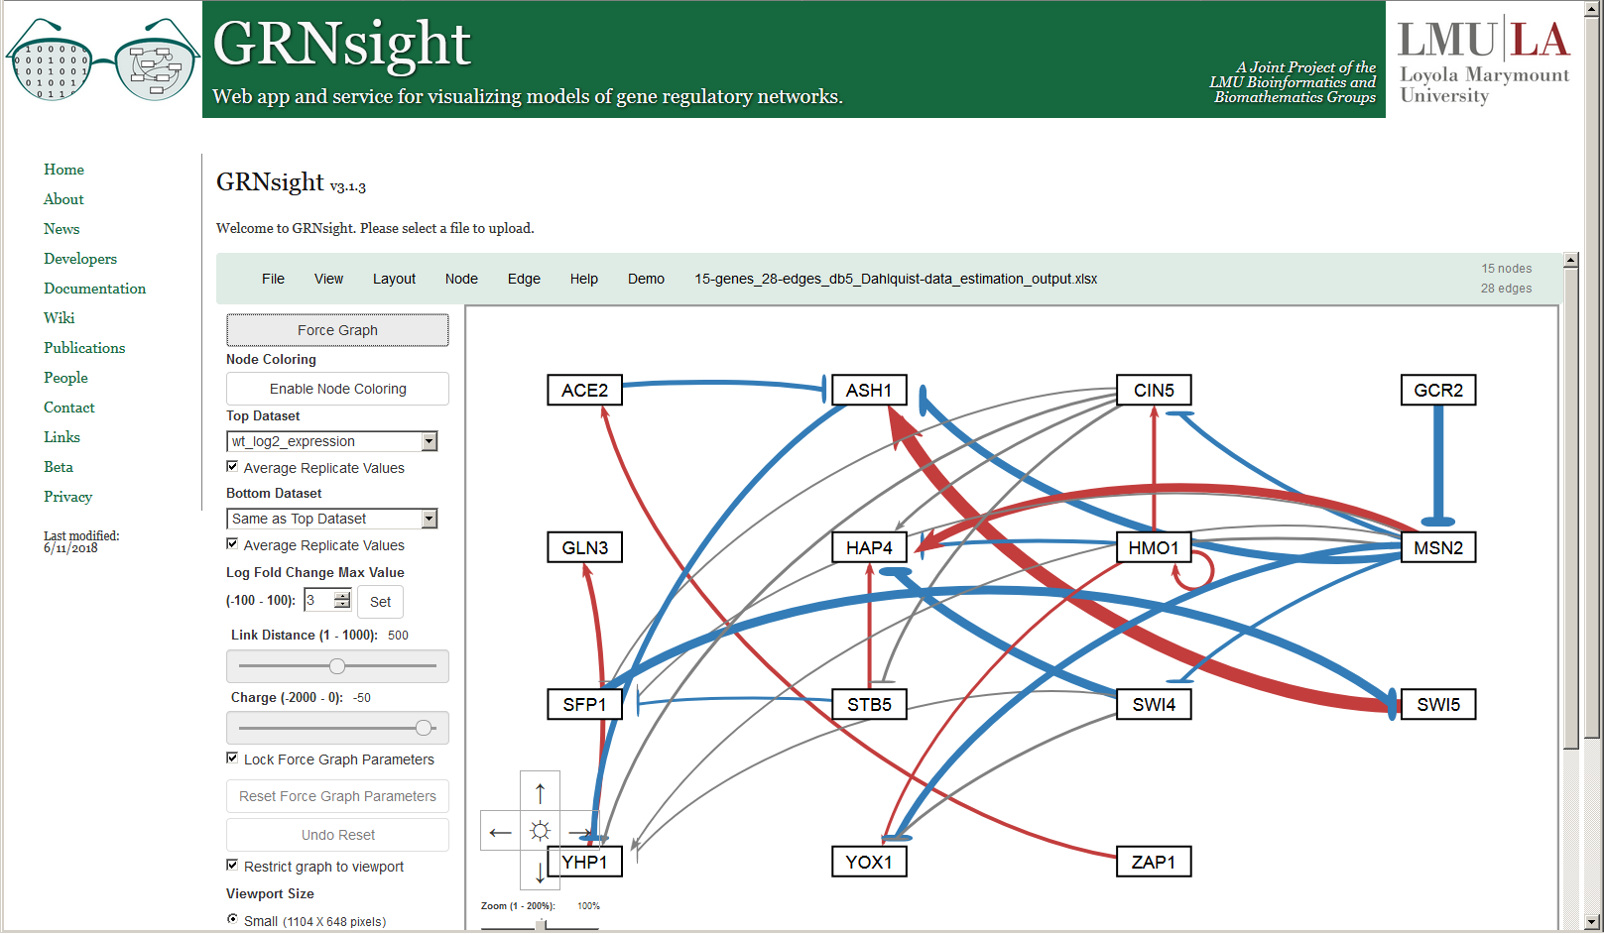
Users Can Change the Gray Threshold with a Slider
Normalization Factor = 5.21
Gray Threshold = 10%
New in Version 2

Slide 15

Users Can Change the Gray Threshold with a Slider
Normalization Factor = 5.21
Gray Threshold = 25%
New in Version 2

Slide 16
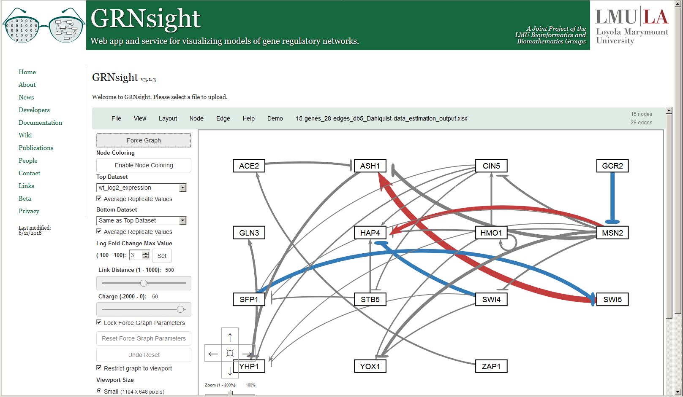
Users Can Change the Gray Threshold with a Slider
Normalization Factor = 5.21
Gray Threshold = 50%
New in Version 2

Slide 17
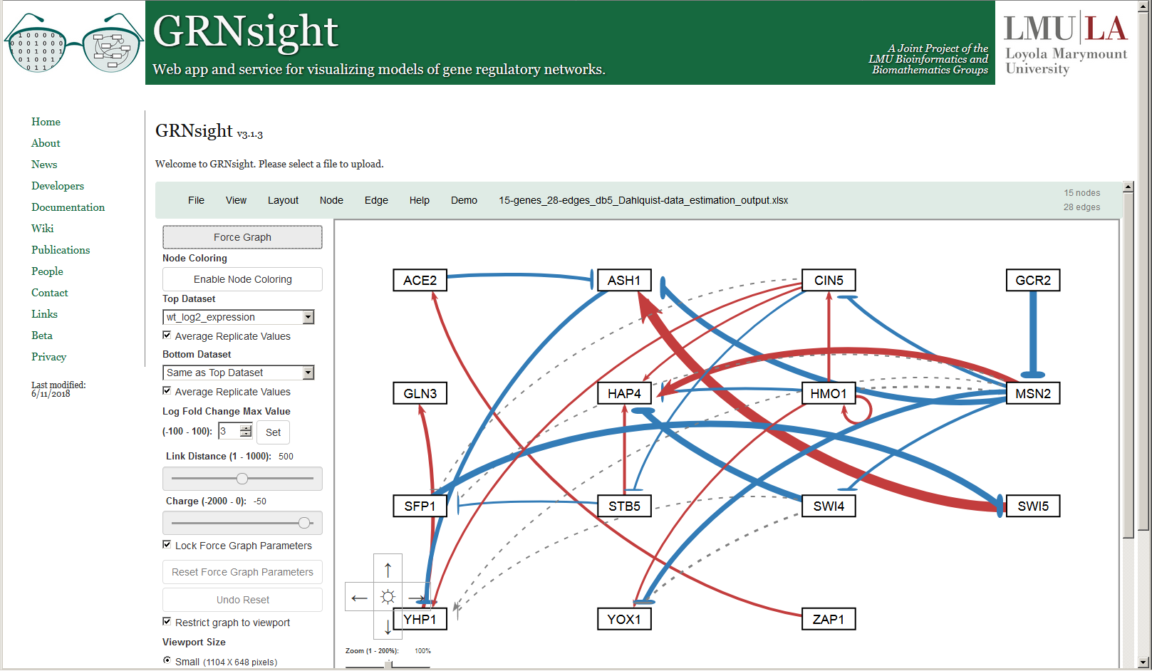
Gray Edges Can Also Be Shown as Dashed Lines to Facilitate Visualization by Color Blind Users
Normalization Factor = 5.21
Gray Threshold = 5%
New in Version 3

Slide 18
Nodes Can Display the Measured and/or Simulated Expression Data as Individual Heat Maps
Top = wild type microarray data
Bottom = wild type model simulated data (GRNmap)
Version 3

Slide 19
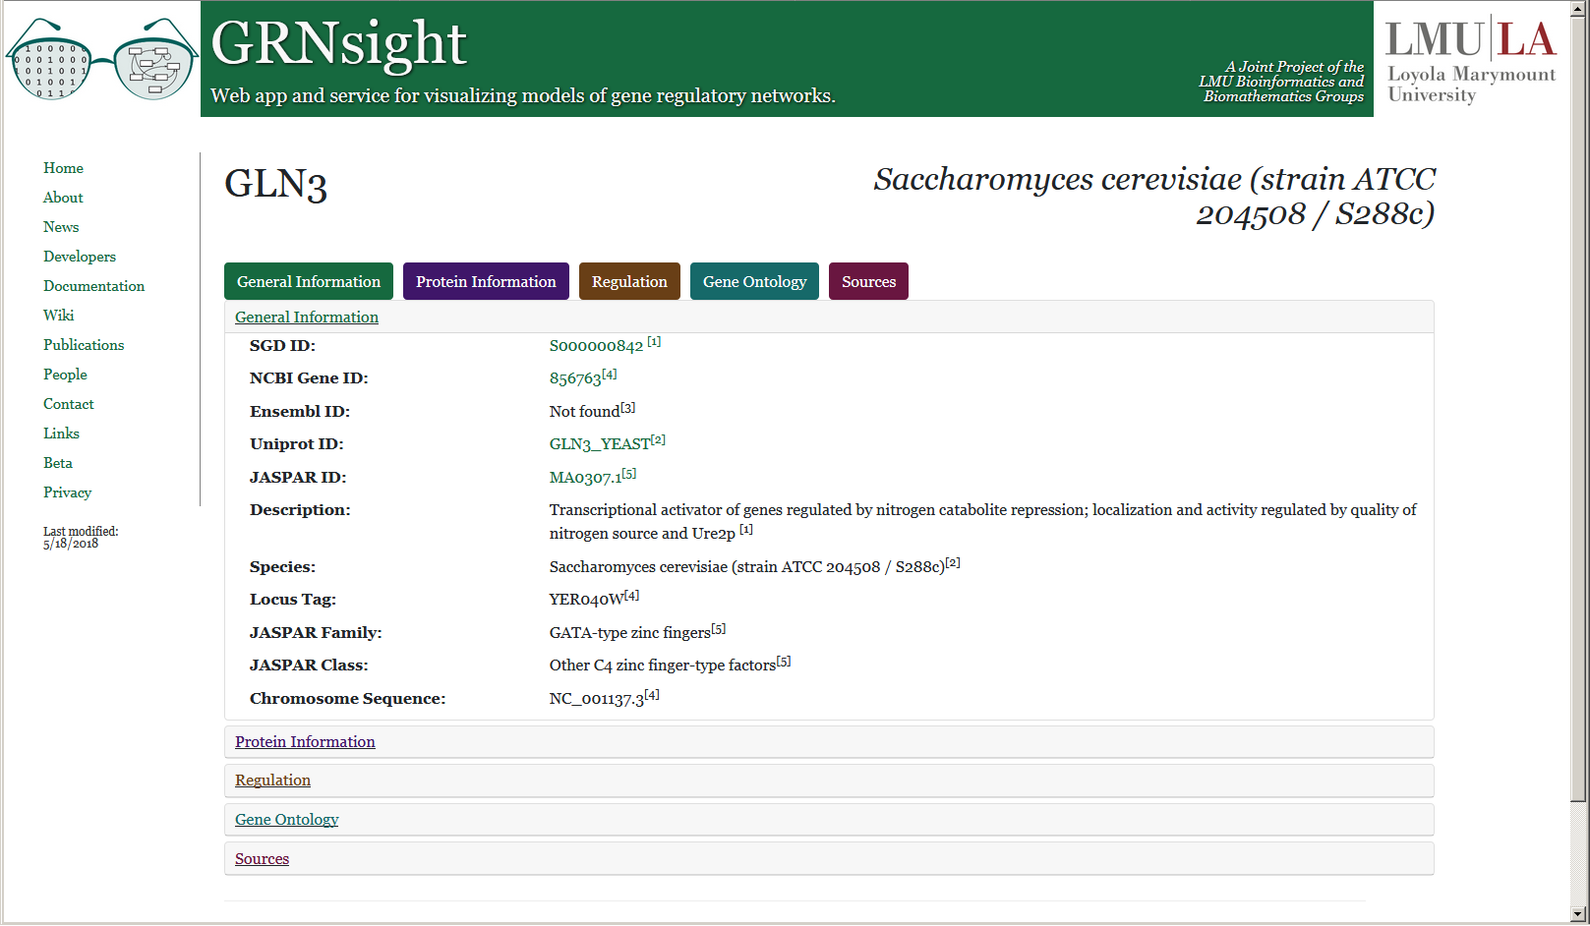
Right-clicking on a Gene Opens a New Web Page with Information Dynamically Retrieved from Source Databases
Version 3

Slide 20

Version 4 of GRNsight has been refactored to a
Model-View-Controller Paradigm
grnstate.js
Model
Updates
Manipulates
update-app.js
View
Controller
setup-handlers.js
Displays To
Uses
User
12 files → 6 files

Slide 21
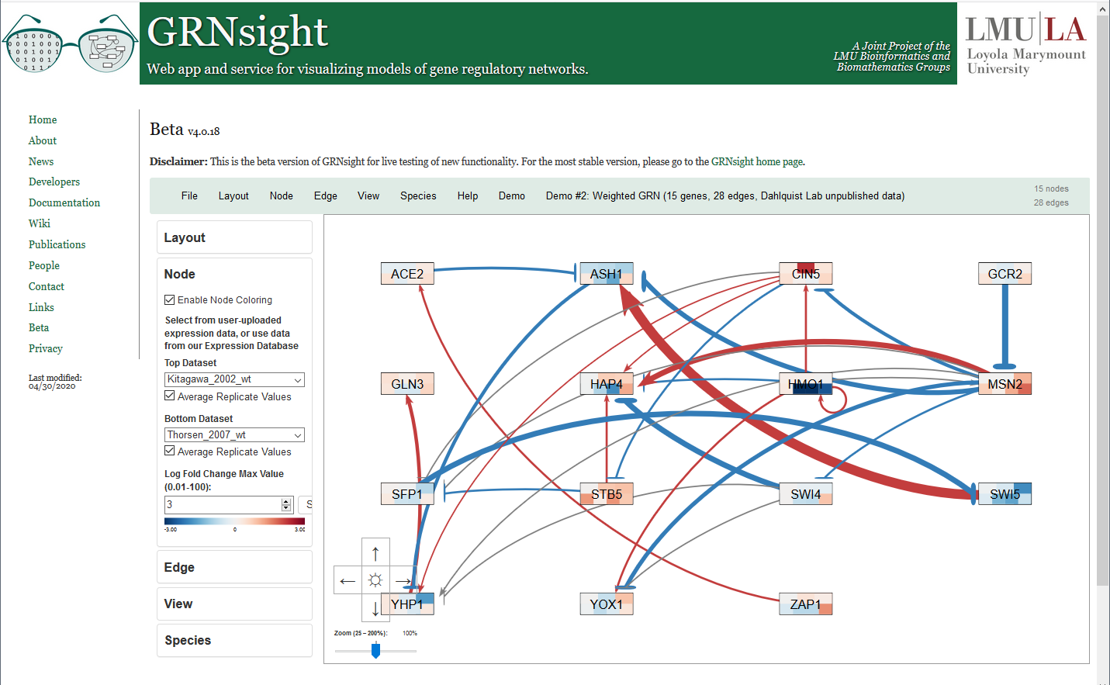
Data from a Backend PostgreSQL Expression Database
Can Now Be Used to Color Nodes
New in Version 4 beta

Slide 22
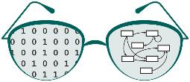
Acknowledgments
John David N. Dionisio
Mihir Samdarshi
Nicole A. Anguiano
Anindita Varshneya
Eileen J. Choe
Yeon-Soo Shin
Alexia M. Filler
John L. Lopez
Edward B. Bachoura
Justin Kyle T. Torres
Kevin B. Patterson
Ona O. Igbinedion
BIOL 367: Biological Databases, Fall 2017 and Fall 2019
LMU Kadner-Pitts Research Grant
LMU Honors Program
LMU Rains Research Assistant Program
Visit us at Poster P5-06!
http://dondi.github.io/GRNsight/
https://github.com/dondi/GRNsight

